Slide 1
Subdivision
CS 460: COMPUTER GRAPHICS
Notes:
Subdividing spline:
http://www.youtube.com/watch?v=iwKgyDQNjeE
Snake like (curve example):
http://www.youtube.com/watch?v=8LhHy7ATtCs
Car body:
http://www.youtube.com/watch?v=V708IbtC6I8&NR=1

Slide 2

Problems with Splines
Traditionally spline patches have been used in production for character animation.
Difficult to model objects with complex topology
(Geri’s Game, Pixar 1998)

Slide 3
Example: Geri’s Game
Subdivision surfaces are used for:
  Geri’s hands and head.
  Clothes: Jacket, Pants, Shirt.
  Tie and Shoes.
(Geri’s Game, Pixar 1998)

Slide 4
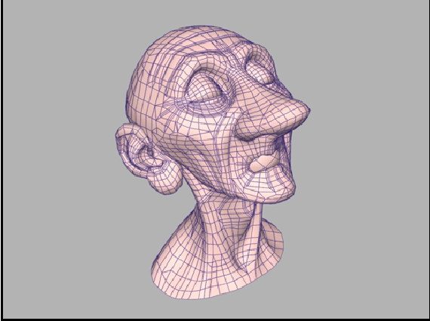
Why Subdivision Surfaces?
Subdivision methods have a series of interesting properties:
  Applicable to meshes of arbitrary topology.
  Compact support. (i.e., changes in a local region won’t affect regions far away)
  Scalability, level-of-detail.
  Numerical stability.
  Simple implementation.
  Affine invariance.
  Continuity.
  Smooth result.

Slide 5
Types of Subdivision
Interpolating Schemes
  Limit Surfaces/Curve will pass through original set of data points.
Approximating Schemes
  Limit Surface will not necessarily pass through the original set of data points.

Slide 6

Subdivision curves
This is another way of making smooth curves…
Idea:
Repeatedly refine the control polygon
Curve is the limit of an infinite process.
input

Slide 7
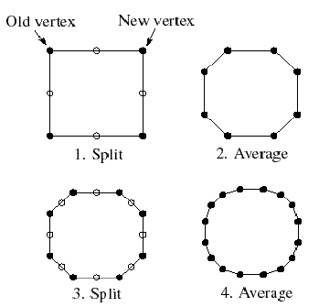
Chaikin’s algorithm
Chaikin introduced the following “corner-cutting” scheme in 1974:
  Start with a piecewise linear curve
  1. Insert new vertices at the midpoints (splitting step)
  2. Average each vertex with its “next” neighbor (average step)
  and Remove the original vertices
  Go to the splitting step (#1)

Slide 8
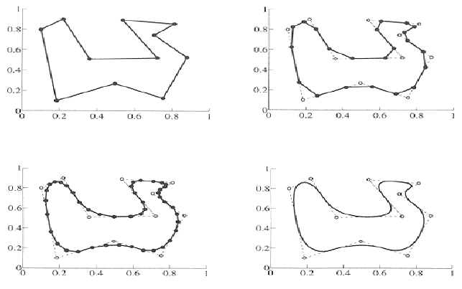
Example
1. splitting
2. averaging
one step
one more step
many steps

Slide 9
Averaging masks
The limit curve is a quadratic B-spline!
Instead of averaging with the two nearest neighbors, we can generalize the averaging equation by applying an averaging mask
during the averaging step:
r = (…, r-1, r0, r1, …)
In case of Chaikin’s algorithm: r = ( 0.5 , 0.5 ),
which means averaging the two nearest neighbors
And the limiting curve is actually a B-spline!

Slide 10
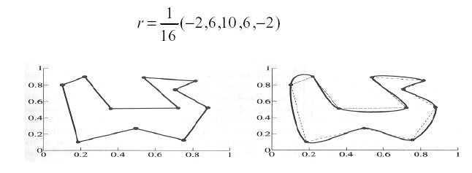
DLG interpolating scheme (1987)
Slight modification to algorithm:
  1. splitting step introduces midpoints
  2. averaging step only changes midpoints and keep the endpoints
For DLG (Dyn-Levin-Gregory) use a different averaging kernel:
Since we only change the midpoints, the limiting curve passes through the control points.
(-2, 5, 10, 5, -2)
i.e. 10, 5, and -2 are applied to the newly created mid-pt,
the endpts, and the two neighboring midpts, respectively
limiting curve passes thru' control pts

Slide 11
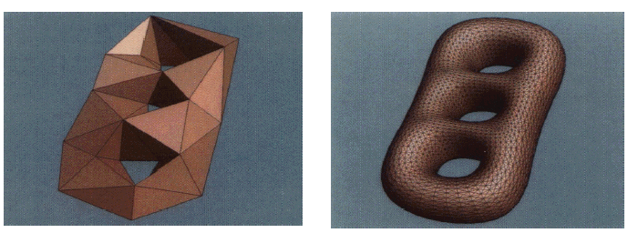
Subdivision Surfaces
This simple idea can be extended to build complex surfaces

Slide 12
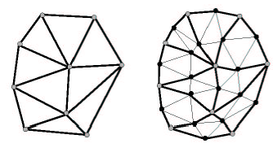
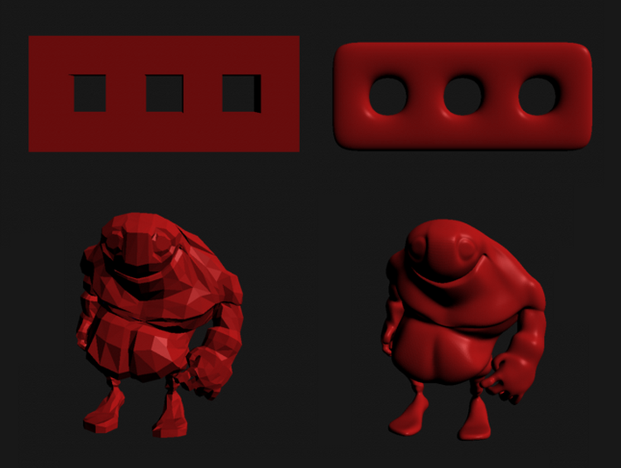
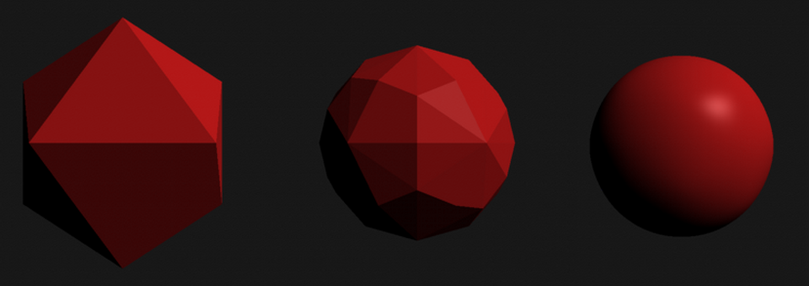
Key Questions in Subdivision
How to refine mesh?
  Topology change
Where to place new vertices?
  Provable properties about limit surface

Slide 13
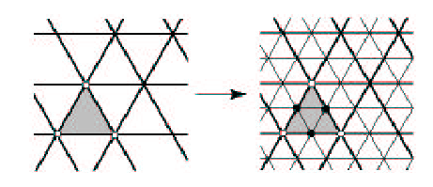
Loop Subdivision Scheme
Useful tutorial, must-read: https://graphics.stanford.edu/~mdfisher/subdivision.html
How to refine mesh?
  Refine each triangle into 4 triangles by splitting each edge and connecting new vertices

Slide 14
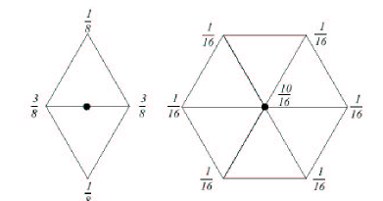
Loop Subdivision Scheme
How to position new vertices?
  Choose locations for new vertices as weighted average of original vertices in local neighborhood
Step 1: Add a vertex on each edge (as a weighted sum of 4 vertices nearby):
Step 2: Reposition all original vertices:

Slide 15


Loop Subdivision Scheme:
Rule for repositioning original vertices

Slide 16
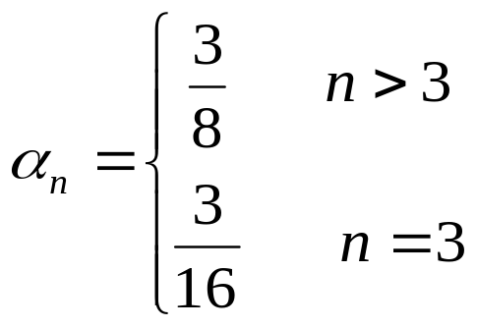

Loop Subdivision Scheme
Set weighting by Warren’s formula:

Slide 17
Loop Subdivision Boundaries
Subdivision Mask for Boundary Conditions
Edge Rule
Vertex Rule

Slide 18

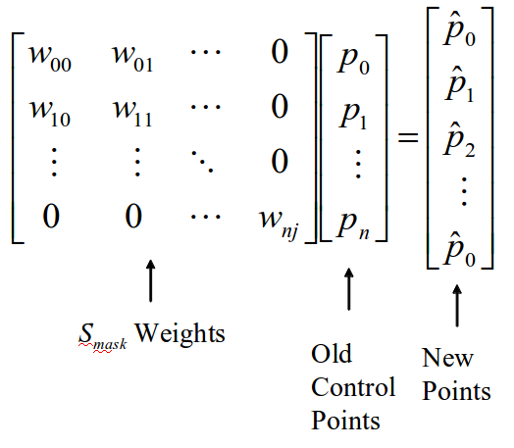
Subdivision as Matrices
Subdivision can be expressed as a matrix S_{mask} of weights w.
  S_{mask} is very sparse
  Never Implement this way!
  Allows for analysis
    Curvature
    Limit Surface

Slide 19
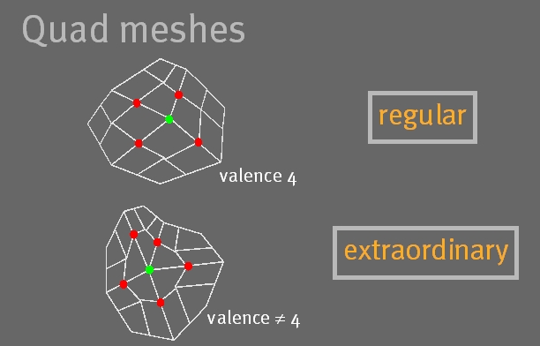
Loop Subdivision Scheme
Works on triangular meshes
Is an Approximating Scheme
Guaranteed to be C2 smooth everywhere except at some extraordinary vertices (vertices with a different valence than the mesh’s default valence)

Slide 20
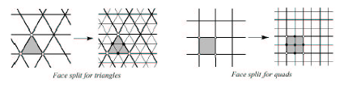
Subdivision Schemes
There are different subdivision schemes
  Different methods for refining topology
Different rules for positioning vertices
  Interpolating versus approximating

Slide 21
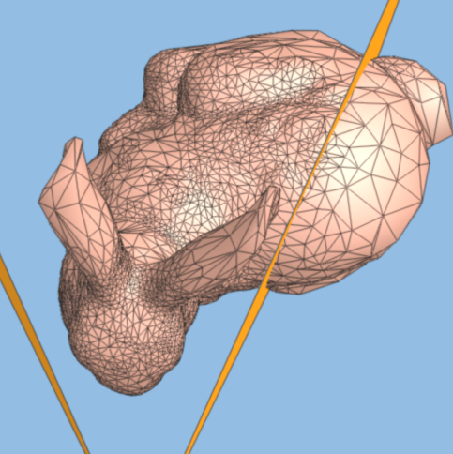
Adaptive Subdivision
Not all regions of a model need to be subdivided.
Idea: Use some criteria and adaptively subdivide mesh where needed.
  Curvature
  Screen size ( make triangles just < size of pixel )
  View dependence
    Distance from viewer
    In view frustum
  Careful! Must ensure that “cracks” aren’t made
crack
subdivide

Slide 22
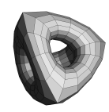
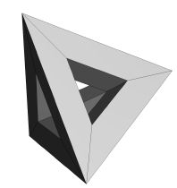
Subdivision Surfaces for Compression
Refinement
(Refinement)⁻¹

Slide 23
Subdivision Surface Summary
  Simple method for describing complex smooth surfaces
  Relatively easy to implement
  Arbitrary topology
  Local support
  Guaranteed continuity
  Multi-resolution
Notes:
http://www.youtube.com/watch?v=ckOTl2GcS-E

Slide 24
Optional Further reading
Hearn & Baker, 10.6 -10.9
Foley, 11.2
Bartels, Beatty, and Barsky. An Introduction to Splines for use in Computer Graphics and Geometric Modeling. 1987.
Farin. Curves and Surfaces CAGD: A Practical Guide. 4th ed. 1997.
Subdivision: http://www.multires.caltech.edu/teaching/courses/subdivision

